Slide 1

Exploring Alzheimer’s Disease Biomarkers with Data Wrangling
Annie G. Bryant
OLET5606 | July 2022
Notes:
Hi all! I’ll be presenting on my data wrangling project looking at Alzheimer’s Disease biomarkers.

Slide 2

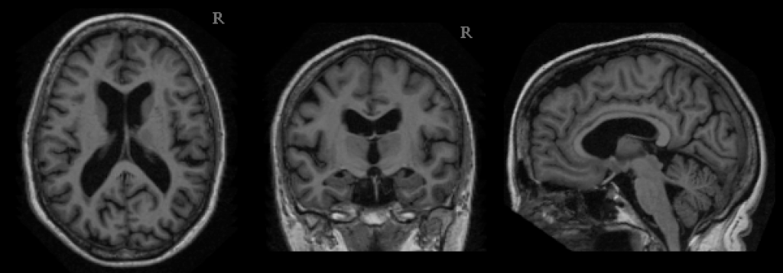
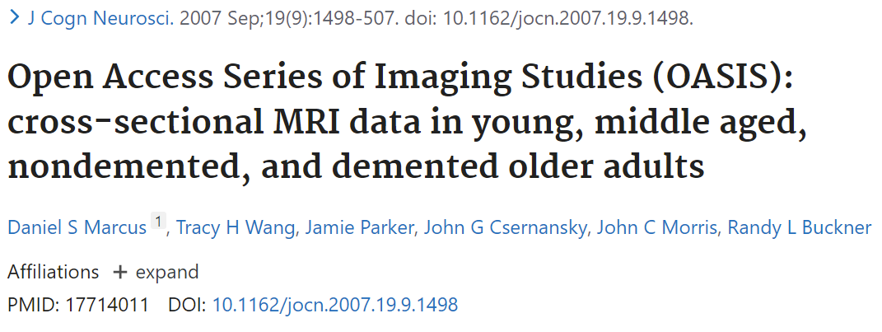
Dataset analysed
Cross-sectional study with 416 participants ages 18-96 seen at the Washington University at St Louis Knight Alzheimer’s Disease Research Center
Three categorical variables: ID, Sex, Handedness
Two ordinal variables: Education, socioeconomic status
Seven continuous variables: Age, Mini Mental State Exam (MMSE), Clinical Dementia Rating (CDR), estimated total intracranial volume (eTIV), normalised whole-brain volume (nWBV), atlas scaling factor (ASF), delay between visits (for 20 participants with a follow-up visit)
Citations in peer-reviewed journals: 1,449
Data maintenance: Central XNAT server
Data availability: open-access after submitting a Data Use Agreement
Notes:
For this project, I used an open-access dataset comprised of 416 participants from the Washington University at St Louis Alzheimer’s Disease Research Center as part of the OASIS study. This dataset came as a CSV file containing a total of 12 variables that include demographics like education level, cognitive scores (like the CDR score, which I’ve highlighted as the outcome variable for modeling), and neuroimaging-derived anatomical features like normalized whole-brain volume.
[click] In terms of data provenance, this dataset is highly cited across over a thousand peer-reviewed journal publications, is regularly maintained at the Central XNAT server, and data is accessible to the public after submitting a Data Use Agreement.

Slide 3
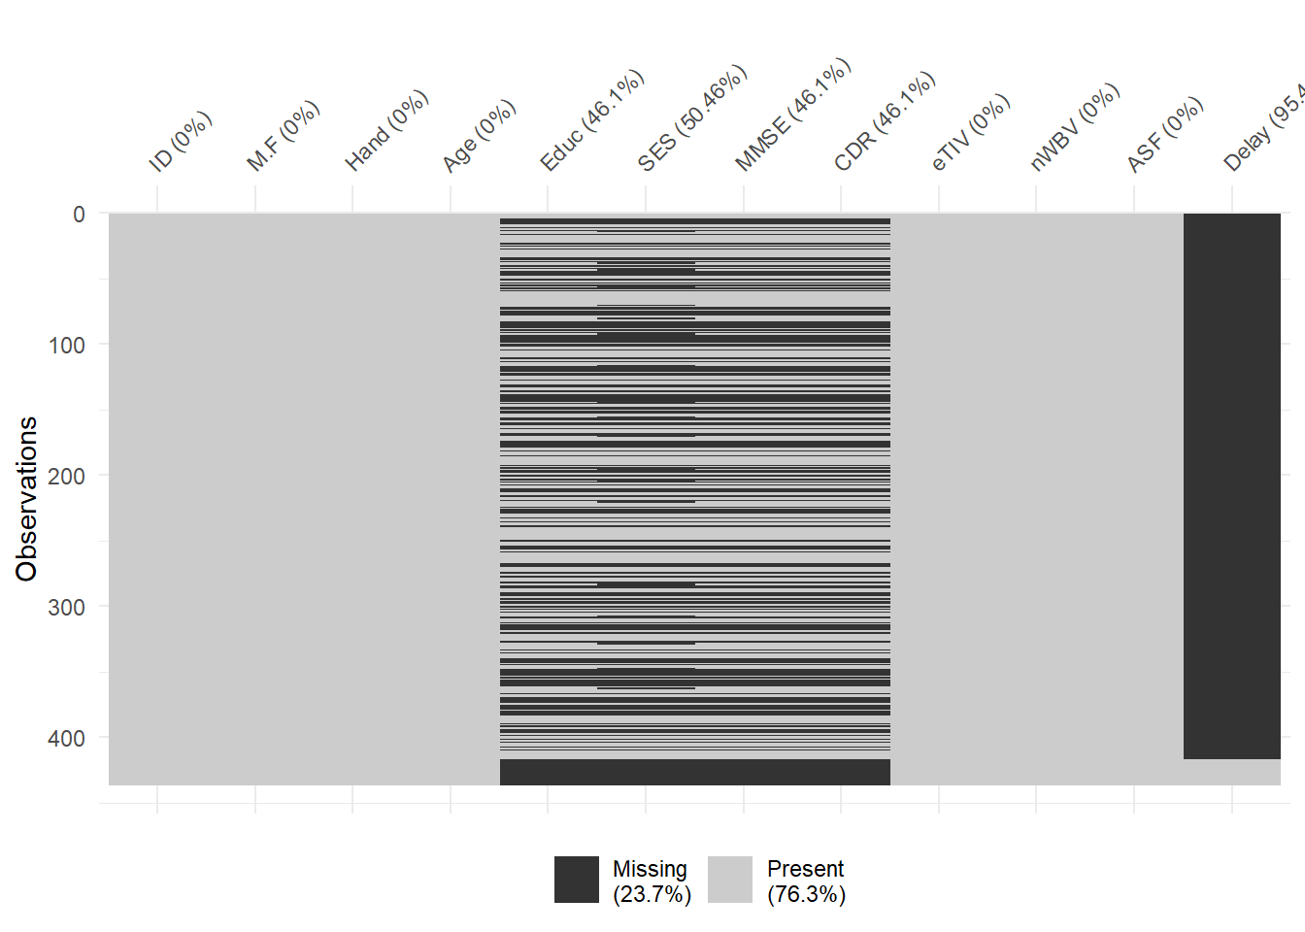
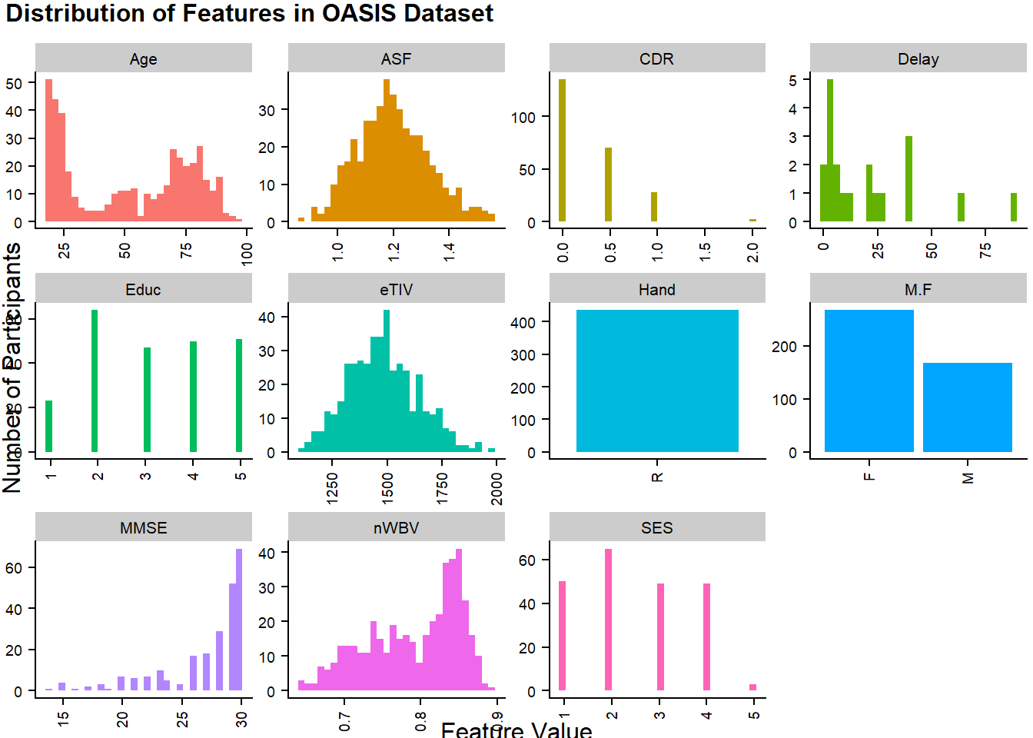
Exploratory data analysis
Examining distribution of variables with dplyr + ggplot
Examining data missingness with naniar
Notes:
I started by exploring the distribution of all of the variables using dplyr and ggplot to generate this combined histogram and bar chart, that shows that some features are normally distribution (like the atlas scaling factor), some are bimodal (like age), and some features actually only have one possible value (like handedness).
[click] I also explored data missingness using the naniar() package, which helped me remove the Delay column since it is irrelevant for most subjects, and I ended up removing all of the subjects with missing data across education, socioeconomic status, and cognitive test scores.

Slide 4
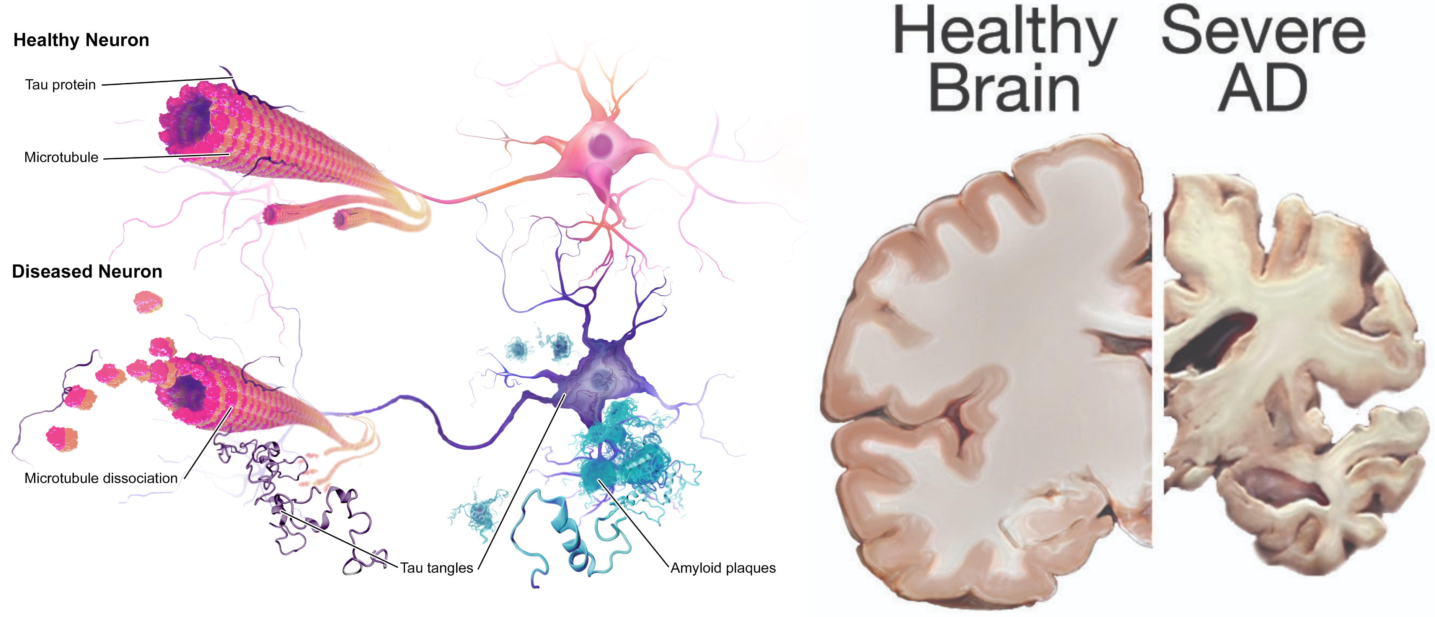
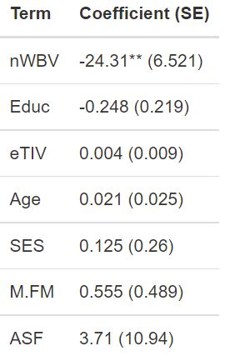
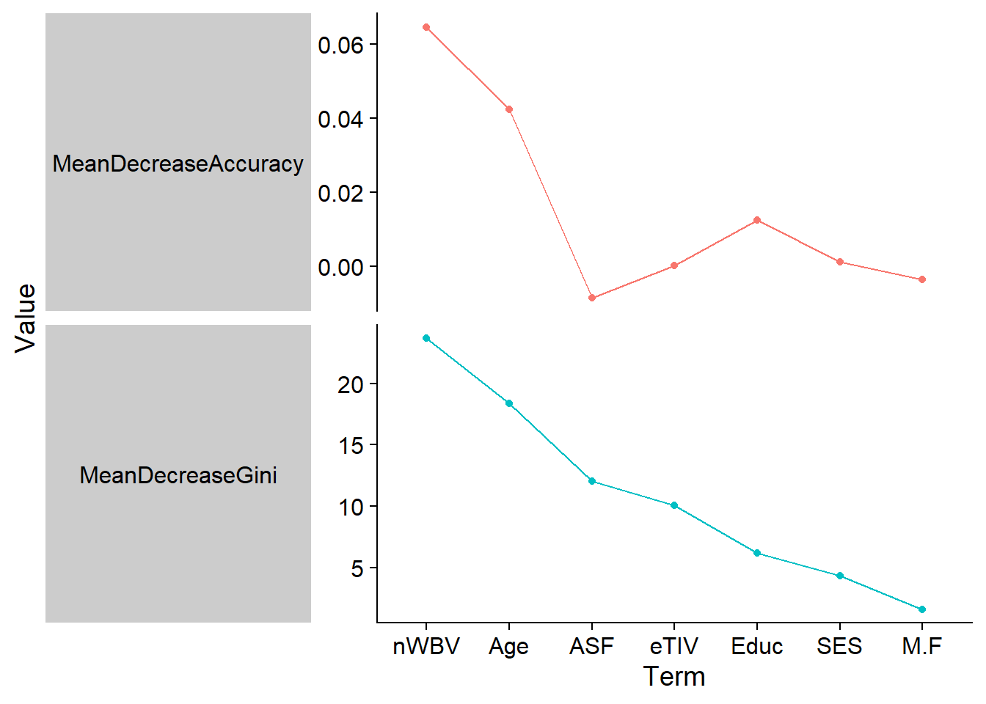
Research question
https://wtcs.pressbooks.pub/nursingfundamentals/chapter/6-3-alzheimers-disease/
Logistic regression
Random forest
Can the anatomical and demographic variables in this dataset predict whether a participant is cognitively healthy (CDR = 0) or has some degree of dementia (CDR > 0)?
 | Logistic Regression | Random forest
In-sample acc | 74.23% | 100%
Out-of-sample acc | 66.04% | 66.04%
Image source: https://wtcs.pressbooks.pub/nursingfundamentals/chapter/6-3-alzheimers-disease/
Notes:
My research question from this dataset asked whether the anatomical and demographic variables in this dataset predict if a patient is cognitively healthy or has dementia.
[click] I used two binary classifiers, logistic regression and random forest, both of which highlighted normalized whole-brain volume as the most informative feature for classification. This makes sense given dementia is generally characterized by severe loss of brain volume, as shown in the figure on the left.
[click] I evaluated the classifiers’ performance in a ten-fold cross validation manner, and found that both classifiers achieved an average of 66% accuracy across the out-of-sample folds.

Slide 5
How data wrangling was used
Exploratory data analysis: dplyr + ggplot for visualizing feature distribution, naniar for surveying presence of missing data
Feature engineering: tidyr::pivot_longer() and dplyr::mutate()
Binary classification: dplyr + tidyr::pivot_longer() to tabulate results across classifiers/folds
Only 210 lines of code were used from start to finish!
Thanks for your attention!
Notes:
To summarize, I used data wrangling throughout this project for exploratory data analysis, feature engineering, and binary classification. Because of the simplicity that these data wrangling tools afford, the entire project including comments only used 210 lines of code.
[click] With that, I’d like to thank you for your attention and take any questions.

